Slide 1
Biomedical NLP in Practice
Matthew Engelhard
Notes:
So far we’ve talked about bag of words
Quite powerful
Let’s take a look at what people are actually using

Slide 2
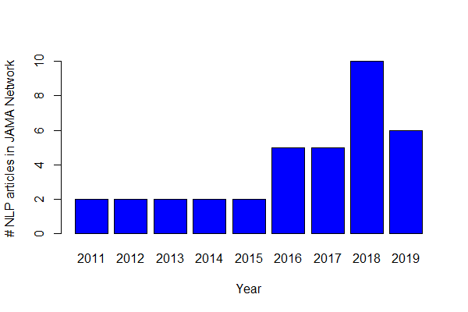
In 2019, I did a brief survey of NLP in JAMA…
Of 28 articles:
27 were based entirely on word counts
Most focused on identifying specific diagnoses or events within notes
Even today, these simple approaches often work best in practice
Notes:
Articles in JAMA that mention NLP as of mid-2019

Slide 3
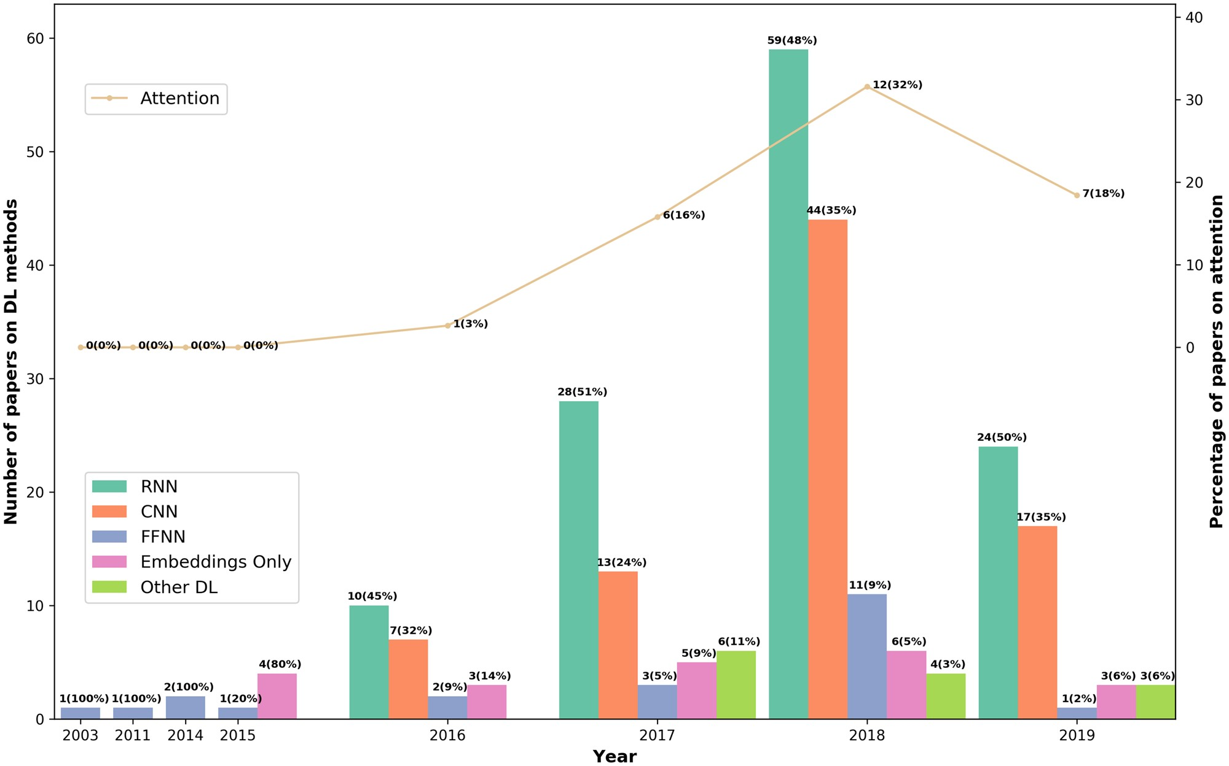
In 2022, deep learning is becoming dominant
Why?
Rarely worse than BoW and often better
Can be very easy to use pre-trained models
J Am Med Inform Assoc, Volume 27, Issue 3, March 2020, Pages 457–470, https://doi.org/10.1093/jamia/ocz200

Slide 4
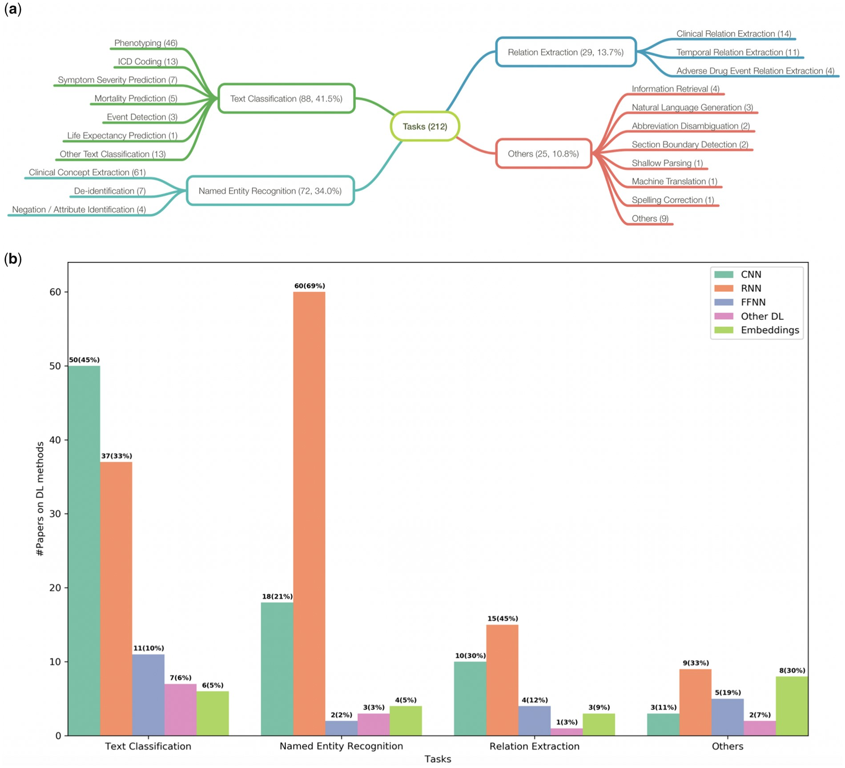
In 2022, deep learning is becoming dominant
Common tasks:
Text classification
(classify a note)
Named entity recognition
(identify clinical concepts within a note)
Relation Extraction
(identify relationships between pairs of concepts within notes)
Others…
J Am Med Inform Assoc, Volume 27, Issue 3, March 2020, Pages 457–470, https://doi.org/10.1093/jamia/ocz200

Slide 5
How does “deep” NLP work?
Answer, part 1: word vectors

Slide 6
Old Tried and true approach: word counts
shaking
what
clinic
how
helps
was
nearest
many
with
said
months
the
morning
mom
should
sickness
and
I
is
how
out
breastfeed
passed
where
I passed out and Mom said I was shaking
x₃
1 | 0 | 0 | 0 | 0 | 1 | 0 | 0 | 0 | 1 | 0 | 0 | 0 | 1 | 0 | 0 | 0 | 2 | 0 | 0 | 1 | 0 | 1 | 0

Slide 7
New approach: we’d like to encode the meaning of each word by assigning numeric attributes
miserable
upset
joyful
melancholy
happy
content
euphoric
sad
unhappy
satisfied
merry
ecstatic
sorrowful
depressed
down
gleeful
<- sadder
happier ->
Attribute 1: how happy or sad is the word?

Slide 8
New approach: we’d like to encode the meaning of each word by assigning numeric attributes
joyful
upset
gleeful
ecstatic
satisfied
merry
unhappy
euphoric
down
depressed
miserable
sorrowful
sad
happy
content
melancholy
<- my kid uses it
nobody uses it ->
Attribute 2: how highfalutin is the word?

Slide 9
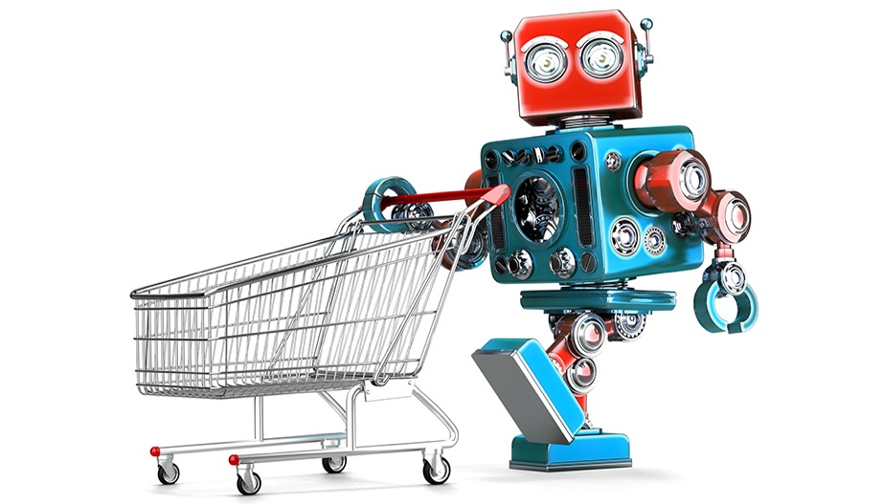
Grocery List
Training a robot to buy groceries
granulated sugar
vanilla extract
dark brown sugar
carrots
table salt
eggs
Example from Anand Chowdhury, MMCi 2019
Notes:
The robot doesn’t know all this stuff – too many grocery items!

Slide 10
Identify items by their attributes (including previously unseen items)
Dimension | 1 | 10
State | Liquid | Solid
Sweetness | Bland | Sweet
Color | Light | Dark
Size | Small | Large
Carrotness | Not really | Platonic essence of carrot

Slide 11
We’re putting all our words on a map…
melancholy
euphoric
sorrowful
We’ll use a few hundred attributes, not just two.
The closer together two words are on this map, the more similar their meaning.
Highfalutin axis
satisfied
sad
Happy axis

Slide 12
Why does this help us?
The model can make sense of words it hasn’t seen before (weren’t used in training)
Similar words (e.g. synonyms) will have similar attributes, and therefore will have similar effect on model predictions
(more complicated) Now we can convert text to a sequence of vectors; and we were already very good at making predictions from sequences of vectors

Slide 13
How do we learn these attributes? -> there’s an additional, optional lecture on this
KEY IDEA: words are defined by the context in which they appear
A man strolls down the street
A woman strolls down the street
A child strolls down the street
A crocodile strolls down the street
A banana strolls down the street
A concept strolls down the street

Slide 14
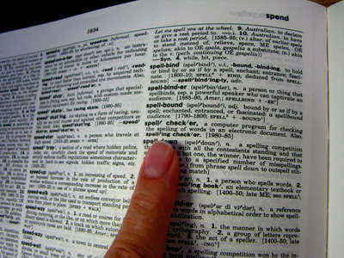
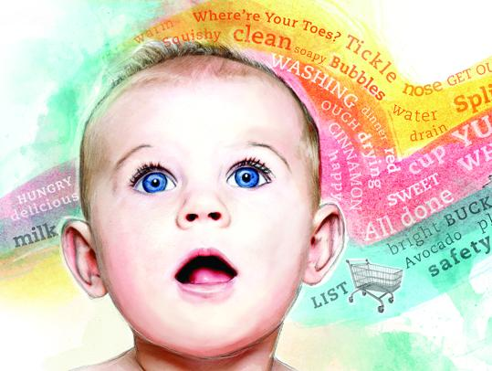
How do we learn these attributes?
KEY IDEA: words are defined by the context in which they appear
-> if words are always exchangeable, they must have very similar meaning
https://www.parenting.com/activities/baby/teach-baby-to-talk/
learn word meaning like an adult:
explicit definitions
learn word meaning like an child:
implicit definitions from context

Slide 15
Now that we have word vectors, how do we use them?
Look up words individually to obtain their vectors
Construct a sequence of vectors
This is a sentence
x_{i}

Slide 16
Now that we have word vectors, how do we use them?
Look up words individually to obtain their vectors
Construct a sequence of vectors
This is a sentence
Now we have a grid of numbers
Similar in many ways to an image
x_{i}

Slide 17
How does “deep” NLP work?
Answer, part 2: hierarchical feature extraction (like in image processing)

Slide 18
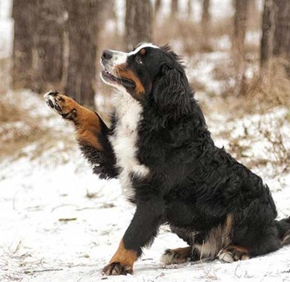
Now we can use deep learning to build our hierarchy of features.
low-level motifs
high-level motifs
dog
edges
shapes
textures
eyes
ears
paws
label
pixels
End goal: predict dog from pixels

Slide 19
Now we can use deep learning to build our hierarchy of semantic features.
low-level motifs
high-level motifs
PE
words
short phrases
concepts
topics
label
grid of semantic attributes
End goal: predict pulmonary embolism from text
Notes:
Much like in deep learning, low-level semantic features are often shared across domains/tasks, but higher level features are more task specific. So again, we can reuse models trained in different domains.

Slide 20
Recall: in image processing, we start with a pre-trained encoder
retinopathy
label
A CNN image encoder that converts the raw image to a vector of high-level motifs / features.
A final layer, or prediction head – this is a logistic regression model – that makes predictions about the label from these high-level features.
We will reuse the encoder but replace the prediction head, since it is specific to the previous (non-medical) task.
vector of high-
level features
CNN
Encoder
image

Slide 21
In modern (deep) NLP, we also start with a pre-trained encoder
PE
label
A transformer network image encoder that converts the raw semantic attributes to a vector of high-level motifs / features.
A final layer, or prediction head – this is a logistic regression model – that makes predictions about the label from these high-level features.
We will reuse the encoder but replace the prediction head, since it is specific to the previous task.
vector of high-
semantic features
NLP
Encoder
grid of semantic attributes

Slide 22
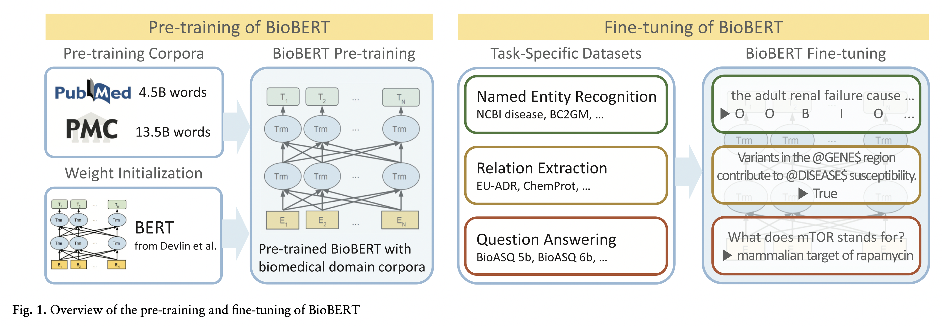
Our encoder (& word vectors) is pre-trained on biomedical corpora.
Lee J, Yoon W, Kim S, Kim D, Kim S, So CH, Kang J. BioBERT: a pre-trained biomedical language representation model for biomedical text mining. Bioinformatics. 2020 Feb 15;36(4):1234-40.
Notes:
Lots of libraries out there for this
Huggingface

Slide 23
Our encoder (& word vectors) is pre-trained on biomedical corpora.
Common encoders (e.g. BERT, GPT3) have millions or billions of parameters (up to 1T)
However, the principles remain the same: neural networks performing hierarchical feature extraction
Different tasks require slightly different final modifications to the encoder
Deep NLP is becoming more accessible (and common in the clinical literature) as tools to acquire and use these encoders continue to improve

Slide 24
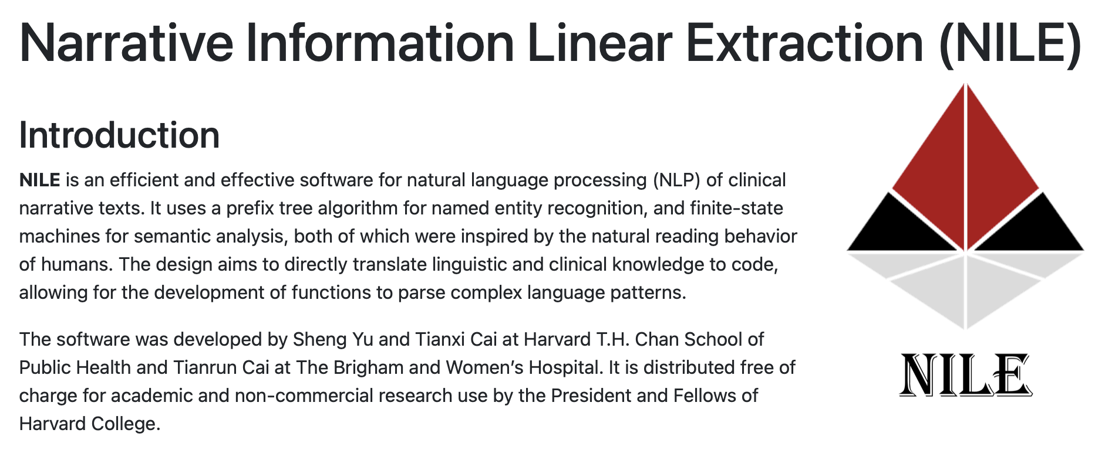
Named Entity Recognition
The old tried and true way:
Unified Medical Language System (UMLS)
Apache cTAKES
Rules-based systems to extract medical concepts from free text
Can then build predictive models based on presence or absence of specific medical concepts
Example: NILE
Best approach in many cases
Fast, easy to implement

Slide 25
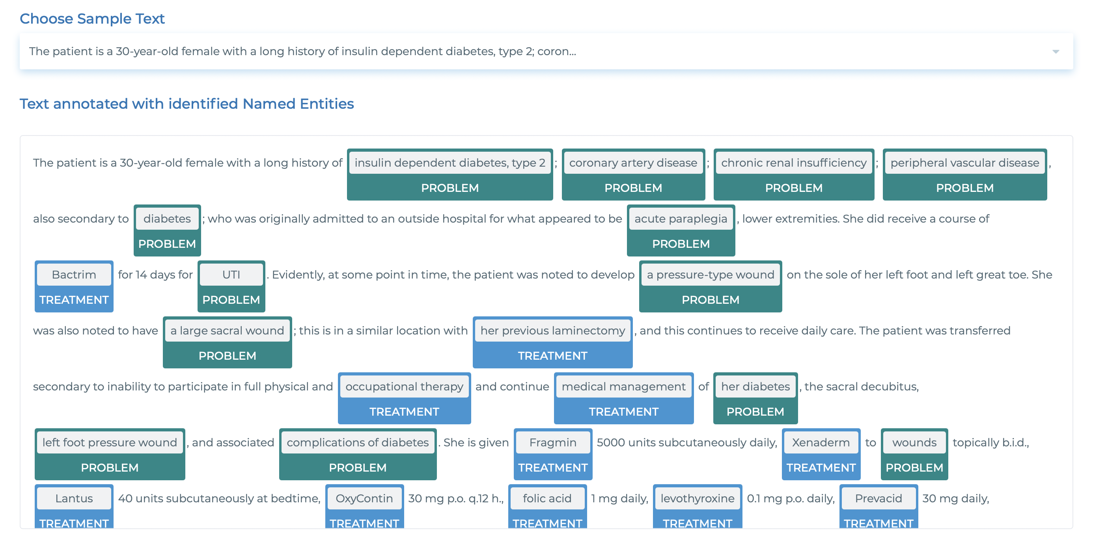
Named Entity Recognition
The new way: deep NLP encoder
https://demo.johnsnowlabs.com/healthcare/NER_CLINICAL/
Notes:
These are now deep learning based models – they’re better.
But the process ends up being the same
Comparison to extraction of features based on segmentation model, then simple model based on that

Slide 26
Conclusions
Text data are central to clinical medicine, so the potential for NLP impact is high (but not yet realized)
Simple, count-based NLP models are surprisingly effective in most clinical applications.
Complex, deep learning NLP models have exceeded human performance. In these models, words are converted to vectors of semantic attributes, and increasingly complex, heirarchical semantic features are then extracted.
Similar to image processing, we can take advantage of complex NLP models by repurposing them for a specific clinical task via fine-tuning of parameters.

Slide 27
A brief note on interpretability…
More on this next time.

Slide 28
We can interpret a count-based NLP model
Suppose you use logistic regression with count-based features, and your model predicts that that an SMS you receive is urgent.
Q: Is it hard to figure out why it made that prediction?
Notes:
Cautions:
not causal
Many predictors can be highly correlated
When we use many predictors, coefficients can be somewhat arbitrary as a result
Don’t assign too much meaning here

Slide 29
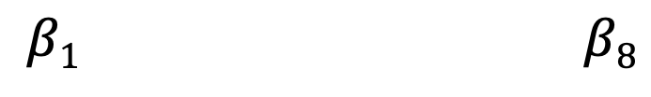
We can interpret a count-based NLP model
Suppose you use logistic regression with count-based features, and your model predicts that that an SMS you receive is urgent.
Q: Is it hard to figure out why it made that prediction?
A: No. You can look at the coefficients to see which words increased and decreased the predicted probability.
LOG ODDS
𝜎
y
shaking
clinic
morning
mom
sickness
breastfeed
passed
where
$$β1 β8$$
y, associated label:
(0 = not urgent, 1 = urgent)
x₁ | x₂ | x₃ | x₄ | x₅ | x₆ | x₇ | x₈
Notes:
Cautions:
not causal
Many predictors can be highly correlated
When we use many predictors, coefficients can be somewhat arbitrary as a result
Don’t assign too much meaning here

Slide 30
Can we interpret a deep learning NLP model?
Suppose you apply a deep neural network to a sequence of word vectors, and your model predicts that that the SMS you receive is urgent.
Q: Is it hard to figure out why it made that prediction?

